Slide 1
Subject-Verb agreement
Vijay Rajesh R

Slide 2
Overview
What is Subject-verb agreement?
Rules & examples of Subject-verb agreement.

Slide 3
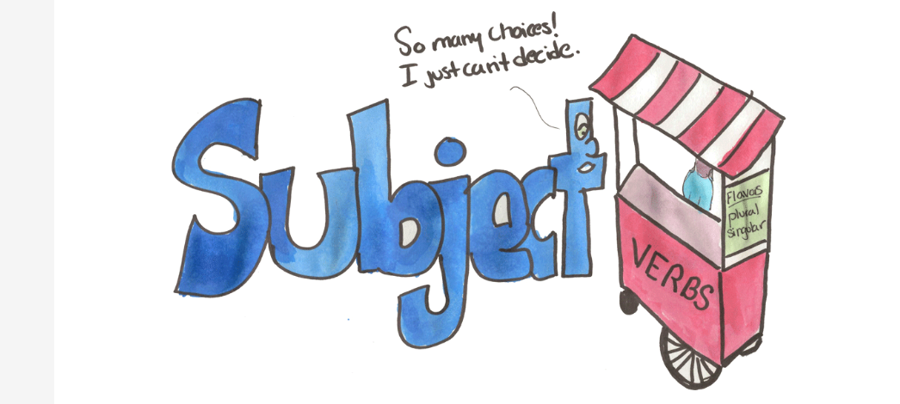
1.What is Subject-verb agreement?
Subject-verb agreement is a grammatical rule that states that the verb in a sentence must agree in number with the subject. In other words, a singular subject takes a singular verb, and a plural subject takes a plural verb.

Slide 4
2. Rules of Subject-verb agreement.
1. Singular subjects take singular verbs, and plural subjects take plural verbs.
- Singular: The cat sleeps on the windowsill.
- Plural: The cats sleep on the windowsill.
2. Compound subjects joined by "and" usually take a plural verb.
- Example: Jack and Jill go up the hill.
3. If the compound subject is treated as a single unit, use a singular verb.
- Example: Peanut butter and jelly is my favorite sandwich.

Slide 5
Thank you
-Vijay Rajesh R

